Slide 1

網頁設計課程 --- 期中專題 Web Design Course --- Midterm Project
~Team1~
Members:
104590024 Yi-Xuan Tsai
104590027 Chih-Fang Chen

Slide 2
規劃

Slide 3
Index
General Information
Faculty
Research Area
About
CSIE
Faculty
Mutimedia Systems
History
Software Systems
Missions
Networked Systems
Strategic Plan
Contact Us

Slide 4
設計

Slide 5
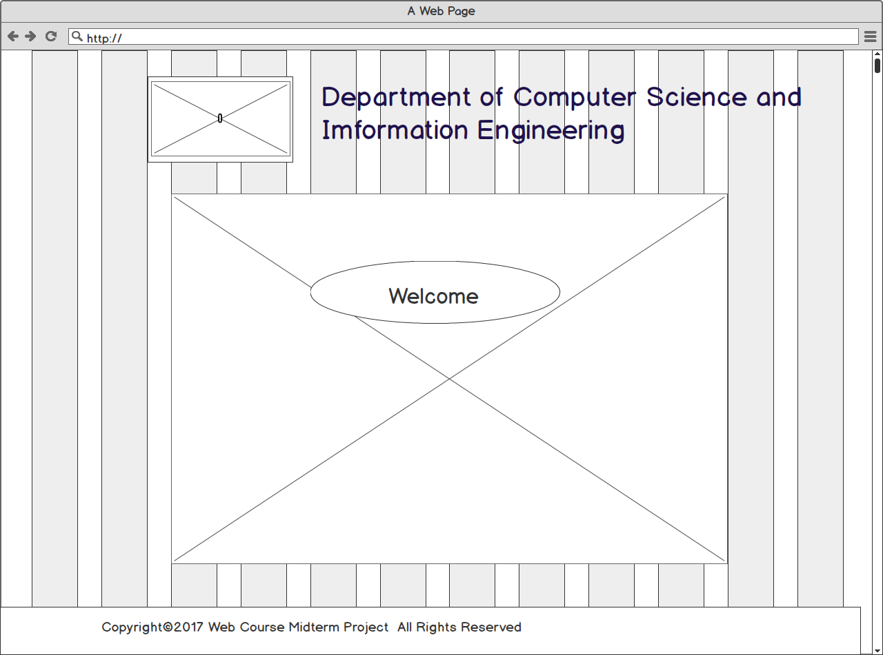
Main Page

Slide 6
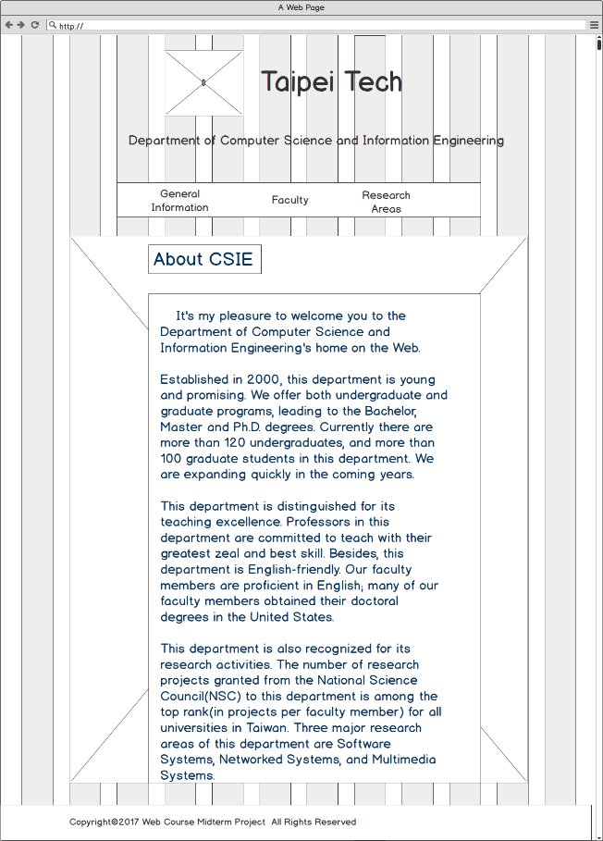
Inside Page

Slide 7
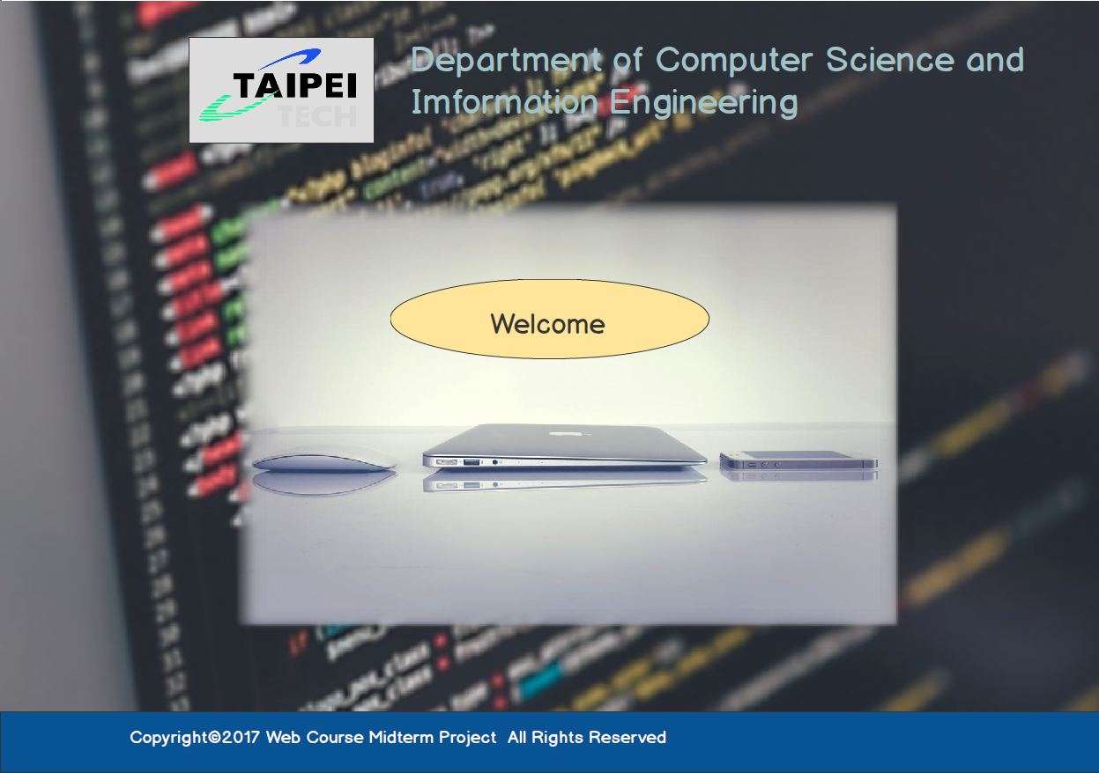

Main Page
採用程式碼當作背景並模糊化,前景採用亮色系以凸顯前景與背景的層次.

Slide 8
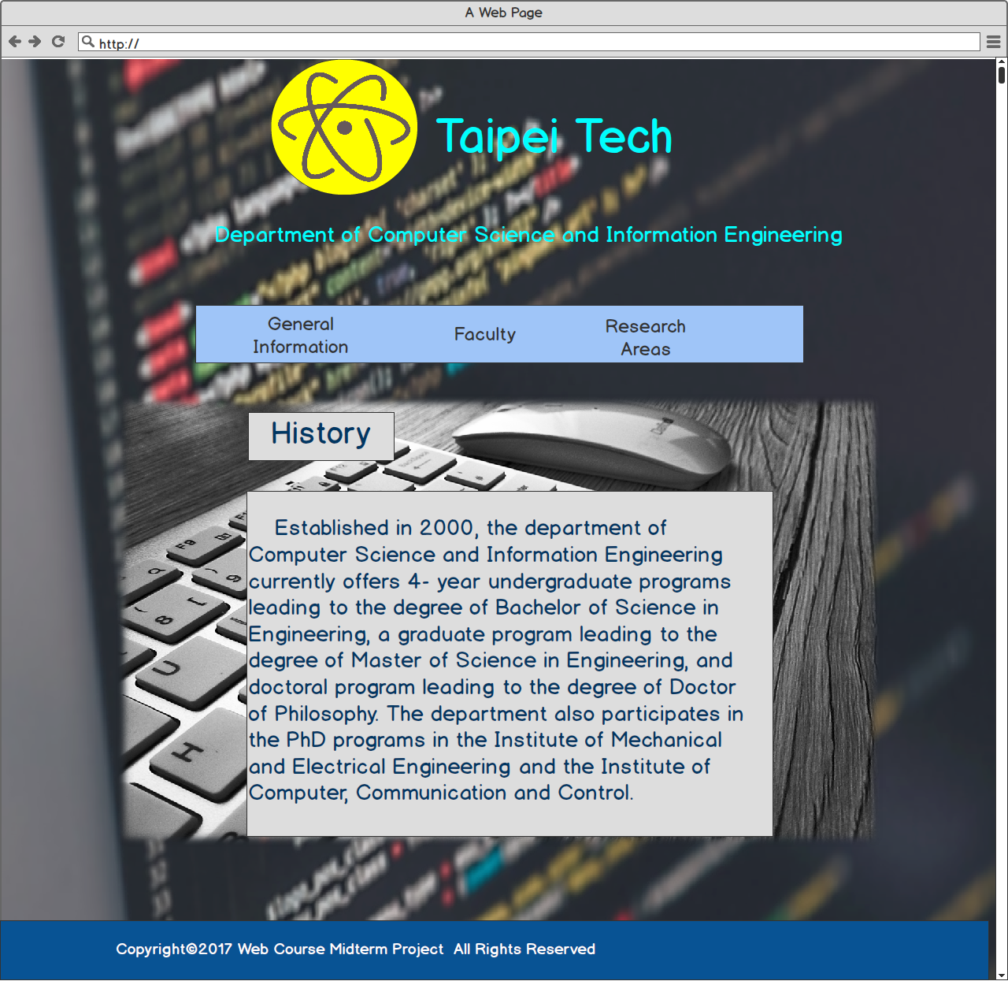
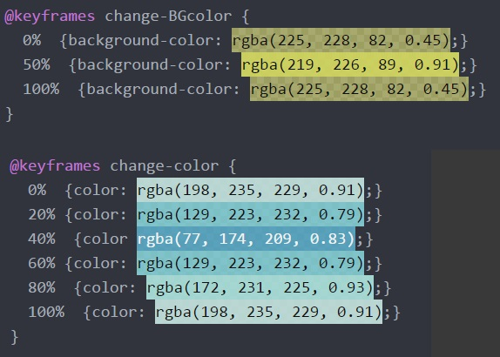
Inside Page
上方Logo與Taipei Tech字樣採對比配色,藍色象徵冷靜與成熟,黃色則象徵活力與熱情.
代表本系學生所應具備能動能靜的特質.
動態改變顏色

Slide 9
DEMO

